Slide 1

Face Mask Detection
Machine learning & content analytics

Slide 2
Our Team
Panagiotis Kosmidis Academics: BSc Informatics Working Env.: Thenamaris Inc.
Konstantinos Alexakis Academics: BSc Informatics Working Env.: Neurocom
Vaggelis Stathis Academics: BSc & MSc Mathematics Working Env.: Neurocom

Slide 3
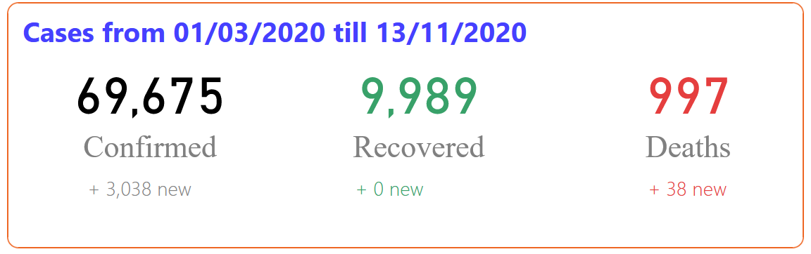
Covid-19
Globally
In Greece
Confimed Cases | Deaths
52,852,674 | 1,295,328

Slide 4
Mask Effectiveness
What evidence do we have that wearing a mask is effective in preventing COVID-19?
Laboratory Studies:
Using high-speed video found that hundreds of droplets ranging from 20 to 500 micrometers were generated when saying a simple phrase, but that nearly all these droplets were blocked when the mouth was covered by a mask.
More details on video https://www.nejm.org/doi/full/10.1056/NEJMc2007800
Social Experiment:
Compare the growth rate on 15 states and the District of Columbia before and after mask mandatory law
After law implementation, the transmission rate decreased by 2% the first three weeks.

Slide 5
Methodology

Slide 6
Image Preprocessing
Dataset
Train
Test [1954]
Validation [3308]
Train [7713]
With Mask
Without Mask
With Mask
Without Mask
With Mask
Without Mask
MaskedFace-Net
Kaggle

Slide 7

Models
SVM
Input Images: 128x64
HOG Technique for feature extraction
Best Model Hyperparameters: kernel=rbf & C=5 & gamma=0.001
Convolutional model Trained with Cropped Face Images
HOG Technique for feature extraction and cropping images
Input Images: 32x32
Model: two Convolutional layers, one Maxpooling layer & two Dense layers
Convolutional model using Keras Image Data Generator
Input Images: 300x300
ImageDataGenerator for data augmentation
Model: five Convolutional layers, five Maxpooling layers & two Dense layers

Slide 8
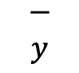
CNN Model Structure
max pool 2x2
max pool 2x2
3x3
3x3
$$\begin{matrix}− \\ y\end{matrix}$$
…
s=1
s=2
s=1
s=2
300x300x1
298x298x16
149x149x16
147x147x32
73x73x32
7x7x64
512

Slide 9
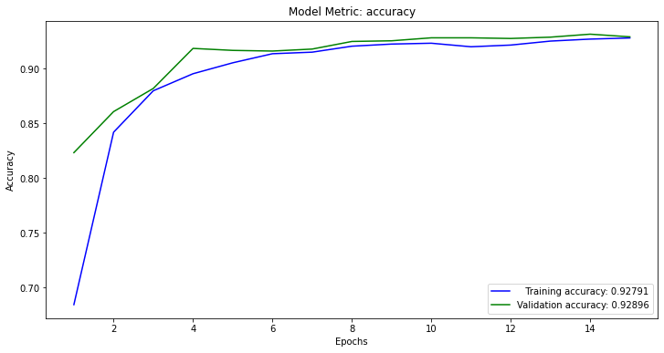
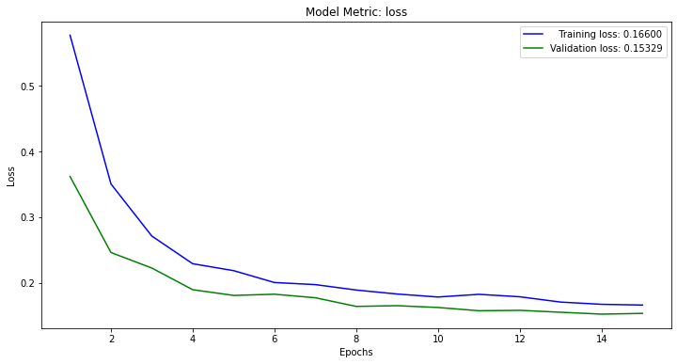
Best Model on Training phase
Accuracy Plot
Loss Plot

Slide 10
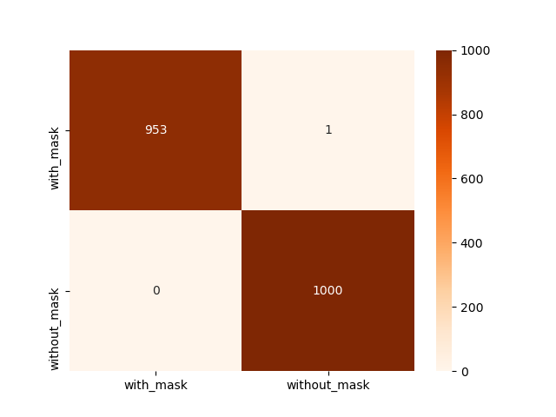
Best Model – Final Results

Slide 11

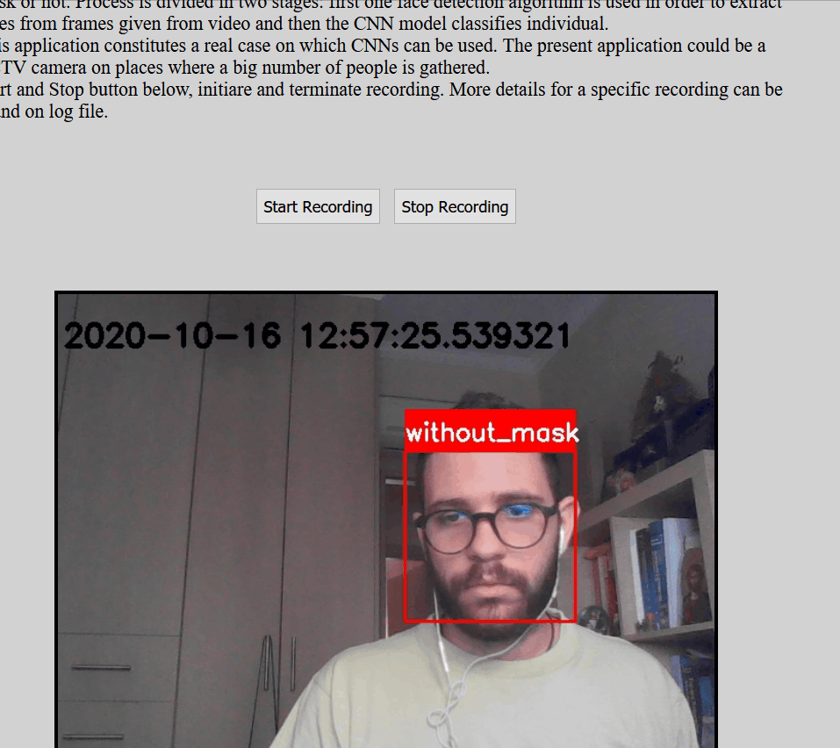
Live Demo

